Slide 1


American International University ,Bangladesh
Faculty of Engineering – Electrical & Electronics Engineering
Presentation on
4 Bit Asynchronous Up Counter
Course- VLSI CIRCUIT DESIGN Instructor: NIRJHOR TAHMIDUR ROUF Sec: F
Group:1

Slide 2
Group Members
Name ID
1. Abu Md Romim Ruhul Ullah 18-36974-1
2. Faizul Karim Polash 18-37315-1
3. Moontansir Mamun Showrov 18-37304-1
4. Sourav Das 18-37400-1 5. Toukir Ahmad 18-37498-1

Slide 3
Presentation Outline
Counter
Synchronous Counter
Asynchronous Counter
Diagram Of 4bit Asynchronous Counter
Advantage of Asynchronous Counter
Disadvantage of Asynchronous Counter
Applications of Asynchronous Counters

Slide 4
Counter
In digital logic and computing, a counter is a device which stores (and sometimes displays) the number of times a particular event or process has occurred, often in relationship to a clock. The most common type is a sequential digital logic circuit with an input line called the clock and multiple output lines. The values on the output lines represent a number in the binary or BCD number system. Each pulse applied to the clock input increments or decrements the number in the counter.

Slide 5
Synchronous Counter
A synchronous counter, in contrast to an asynchronous counter, is one whose output bits change state simultaneously, with no ripple.
The only way we can build such a counter circuit from J-K flip-flops is to connect all the clock inputs together, so that each and every flip-flop receives the exact same clock pulse at the exact same time.
Synchronous Counters are so called because the clock input of all the individual flip-flops within the counter are all clocked together at the same time by the same clock signal

Slide 6
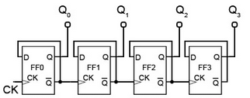
Asynchronous Counter
An Asynchronous counter can count using Asynchronous clock input. Counters can be easily made using flip-flops. As the count depends on the clock signal, in case of an Asynchronous counter, changing state bits are provided as the clock signal to the subsequent flip-flops. Those Flip-flops are serially connected together, and the clock pulse ripples through the counter. Due to the ripple clock pulse, it’s often called a ripple counter. An Asynchronous counter can count 2^{n} - 1 possible counting states.

Slide 7
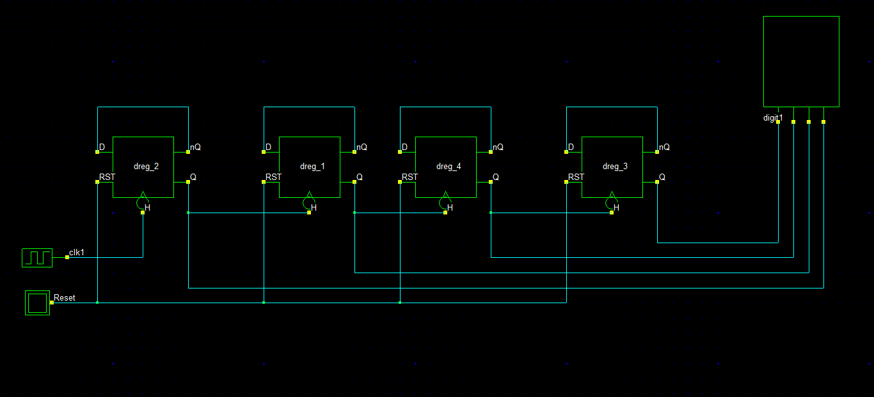
Diagram Of 4bit Asynchronous Up Counter

Slide 8
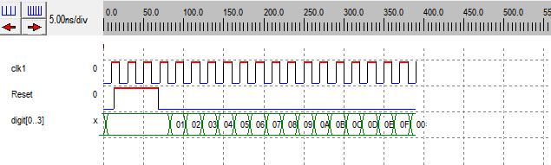
Time Diagram

Slide 9
Truth Table
CLK | Q4 | Q3 | Q2 | Q1 | Decimal No.
Initial | 0 | 0 | 0 | 0 | 0
1 | 0 | 0 | 0 | 1 | 1
2 | 0 | 0 | 1 | 0 | 2
3 | 0 | 0 | 1 | 1 | 3
4 | 0 | 1 | 0 | 0 | 4
5 | 0 | 1 | 0 | 1 | 5
6 | 0 | 1 | 1 | 0 | 6
7 | 0 | 1 | 1 | 1 | 7
8 | 1 | 0 | 0 | 0 | 8
9 | 1 | 0 | 0 | 1 | 9
10 | 1 | 0 | 1 | 0 | 10
11 | 1 | 0 | 1 | 1 | 11
12 | 1 | 1 | 0 | 0 | 12
13 | 1 | 1 | 0 | 1 | 13
14 | 1 | 1 | 1 | 0 | 14
15 | 1 | 1 | 1 | 1 | 15

Slide 10
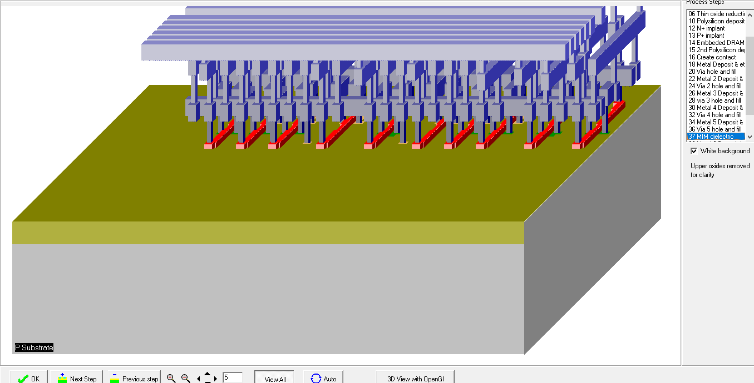
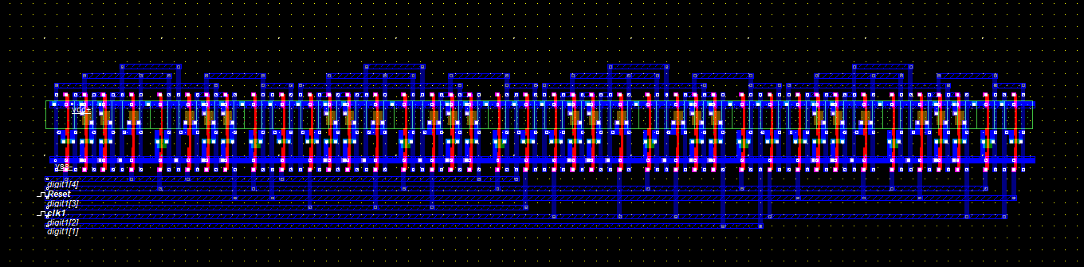
3D representation form Microwind

Slide 11
Advantage of Asynchronous Counter
Asynchronous counters can be easily designed by T flip flop or D flip flop.
These are also called as Ripple counters, and are used in low speed circuits.
They are used as Divide by- n counters, which divide the input by n, where n is an integer.
Asynchronous counters are also used as Truncated counters. These can be used to design any mod number counters, i.e. even Mod or odd Mod

Slide 12
Disadvantage of Asynchronous Counter
Sometimes extra flip flop may be required for “Re synchronization”.
To count the sequence of truncated counters (mod is not equal to 2n), we need additional feedback logic.
While counting large number of bits, the propagation delay of asynchronous counters is very large.
For high clock frequencies, counting errors may occur, due to propagation delay.

Slide 13
Applications of Asynchronous Counters
Asynchronous counters are used as frequency dividers, as divide by N counters.
These are used for low power applications and low noise emission.
These are used in designing asynchronous decade counter.
Also used in Ring counter and Johnson counter.
Asynchronous counters are used in Mod N ripple counters.

Slide 14
Thank You

